Slide 1


DYNAMIC WEBPAGE ON STOCKS
Presented by-
Kushal Rathi-160120747034
Rithvik Ramdas-160120747043
Under the guidance of-
Dr D. L. Sreenivasa Reddy

Slide 2



EXISTING SYSTEMS

Slide 3
There are many famous websites for stocks like NSE, BSE, upstox. These websites give every information about stocks , like history of the stock, increase and decrease of the market.
So, the person who wants to invest can get a clear idea about the market.

Slide 4

DRAWBACKS OF EXISTING SYSTEMS

Slide 5
New users who do not have an idea about how stock markets work they might get confused on where to invest and in which company to invest.
It is important that we give some tips and important points to such beginners, which are not there in the existing websites or apps.
And the existing apps also charge grade percentage as commision based on the money we trade which is called as brokerage

Slide 6

PROBLEM STATEMENT

Slide 7
The youth nowadays looks up to the stock market as a resource for them to start their side income but with no proper knowledge and also no history of stocks provided they find it difficult to make their way through the stock market

Slide 8

MOTIVATION

Slide 9
Earlier people used to get information about stocks from newspaper which was not very convenient everywhere ,but now with invention of mobiles people can access information related to stocks from websites.
Nowadays every youngsters aims to have financial freedom, so stocks can be the first step for them to start their earning by understanding the market.

Slide 10

SOFTWARE AND HARDWARE REQUIREMENTS

Slide 11
Operating System: Windows 7/8/10
Tools: Visual Studio Code
Processor: Intel Pentium
Processor Speed: 1.5GHZ
RAM: 4GB or above
Hard Disk: 50GB or above

Slide 12

SYSTEM DESIGN

Slide 13
Graphical view of the top company's stocks to get clear idea of their market
Giving tips to the people who would like to invest in one of the top company's stocks
Some important tips that we are going to include in our website:
Start with small capital in the initial days
Use a demo trading account to improve trade accuracy
Always have a stop loss and target price before placing a trade
Understand technical and fundamental analysis if you want to be a stock trader/investor
Diversify your investment if you have long-term investing goal

Slide 14
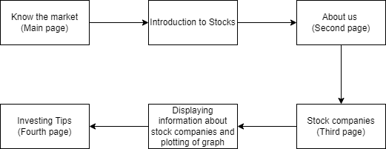

Slide 15

IMPLEMENTATION

Slide 16
HTML(Hypertext Markup Language) defines the structure, and the contents of our web page-where things go , how they are laid out , and what's on the page
CSS(Cascading Style Sheets) is a style sheet used for describing the presentation of a document written in a markup language such as HTML. It creates an attractive layout.
TailWind focuses on simplifying the development of informative web pages. It helps in creating a responsive design mobile friendly site.
And JAVASCRIPT to display the live graphs

Slide 17

FINAL OUTPUTS

Slide 18
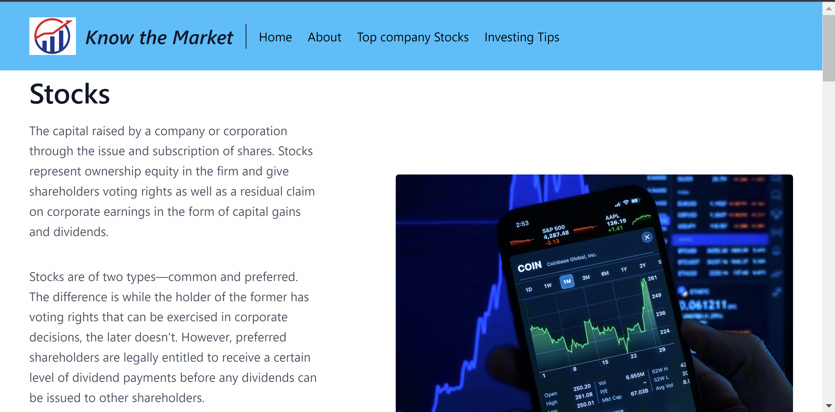
Home Page

Slide 19
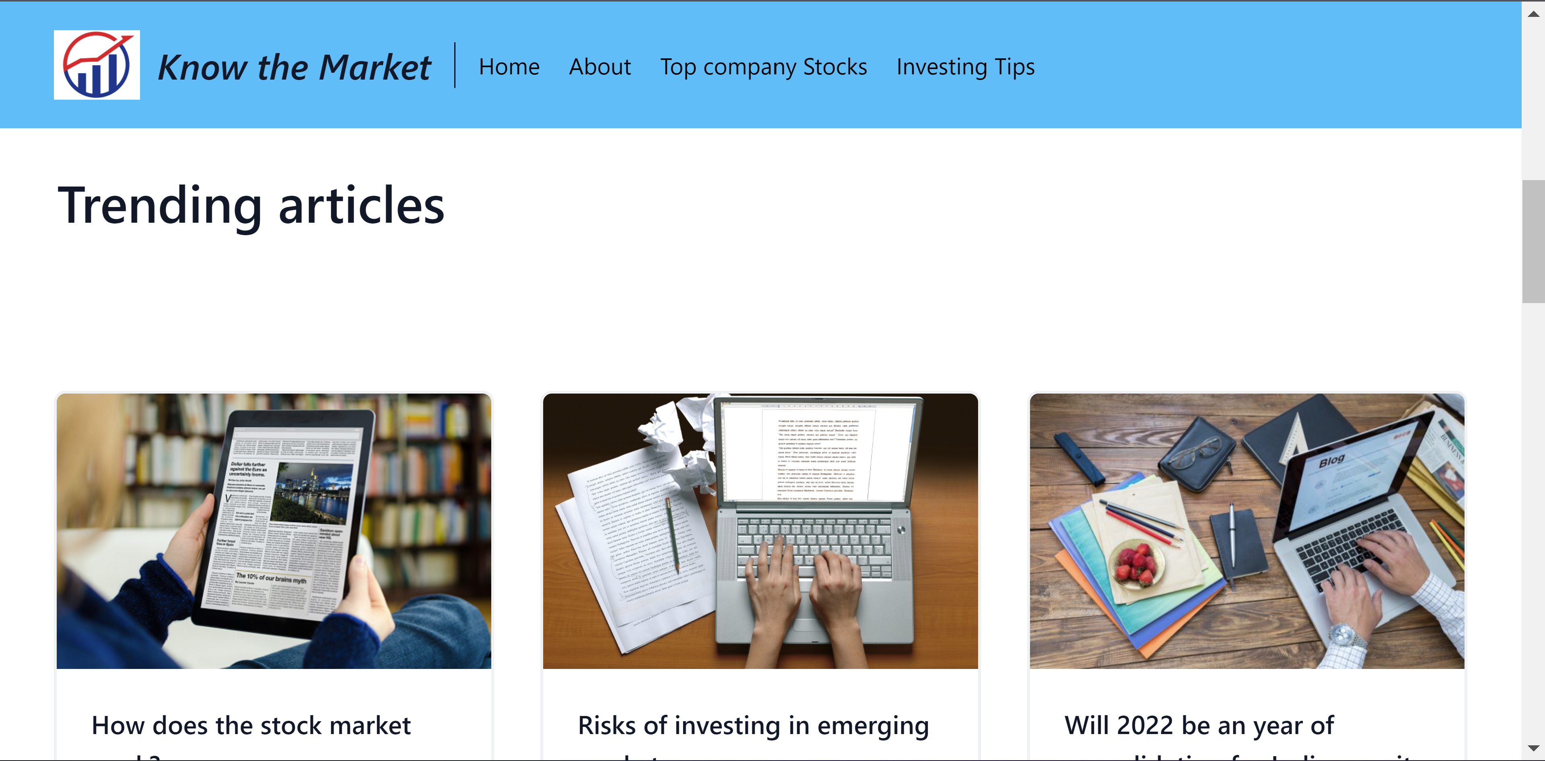

Slide 20
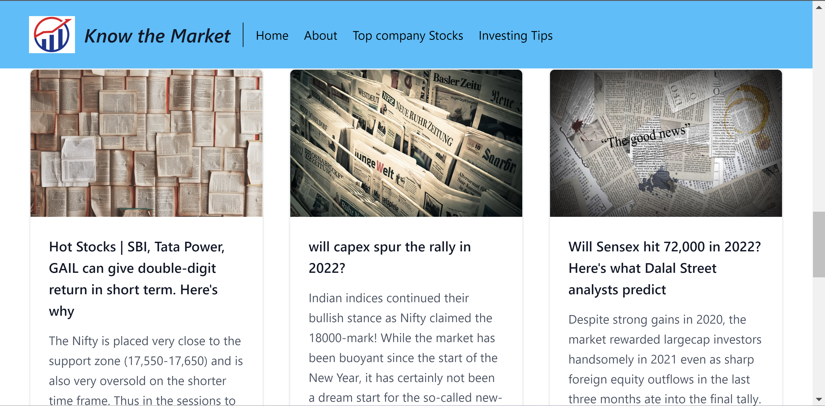

Slide 21
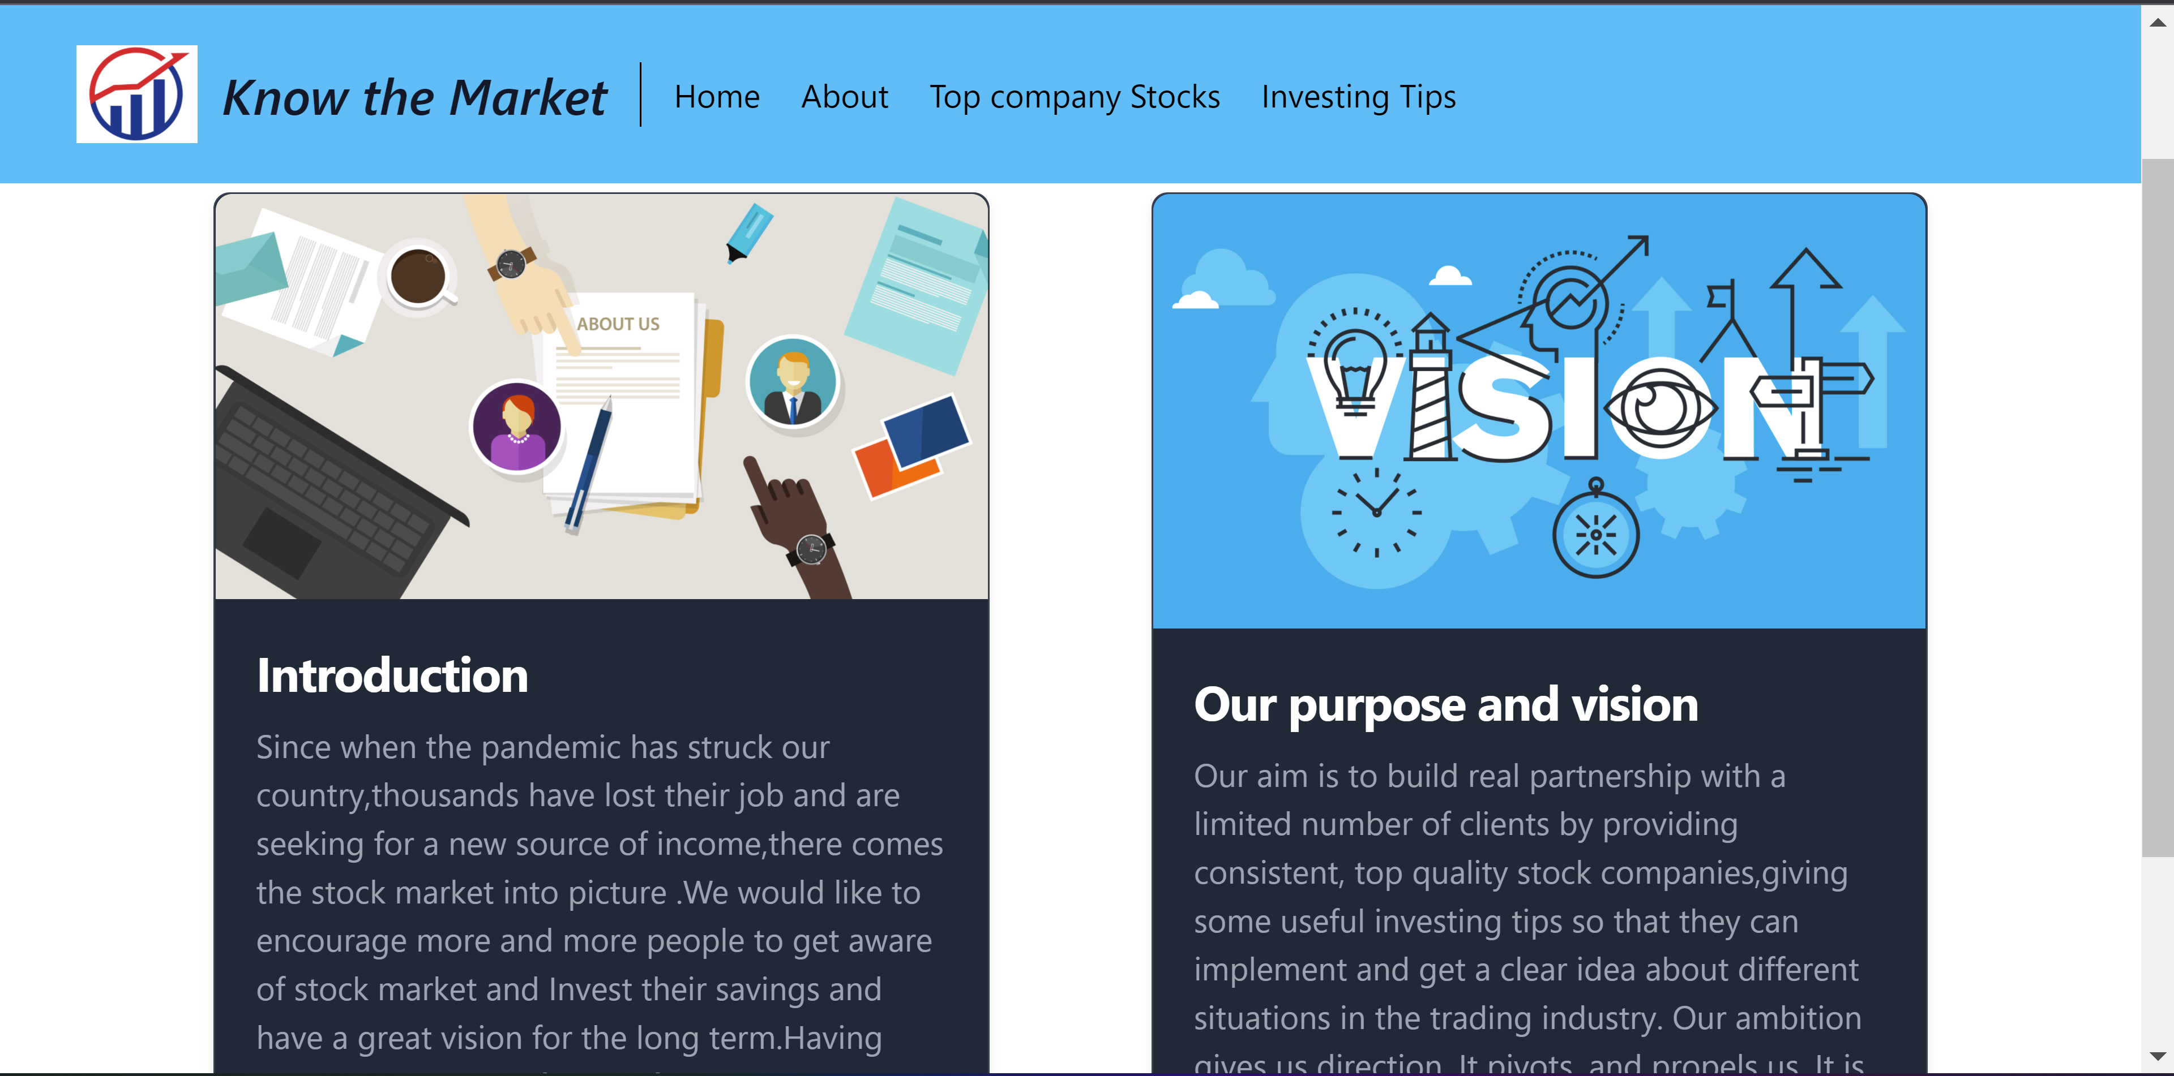
About Page

Slide 22
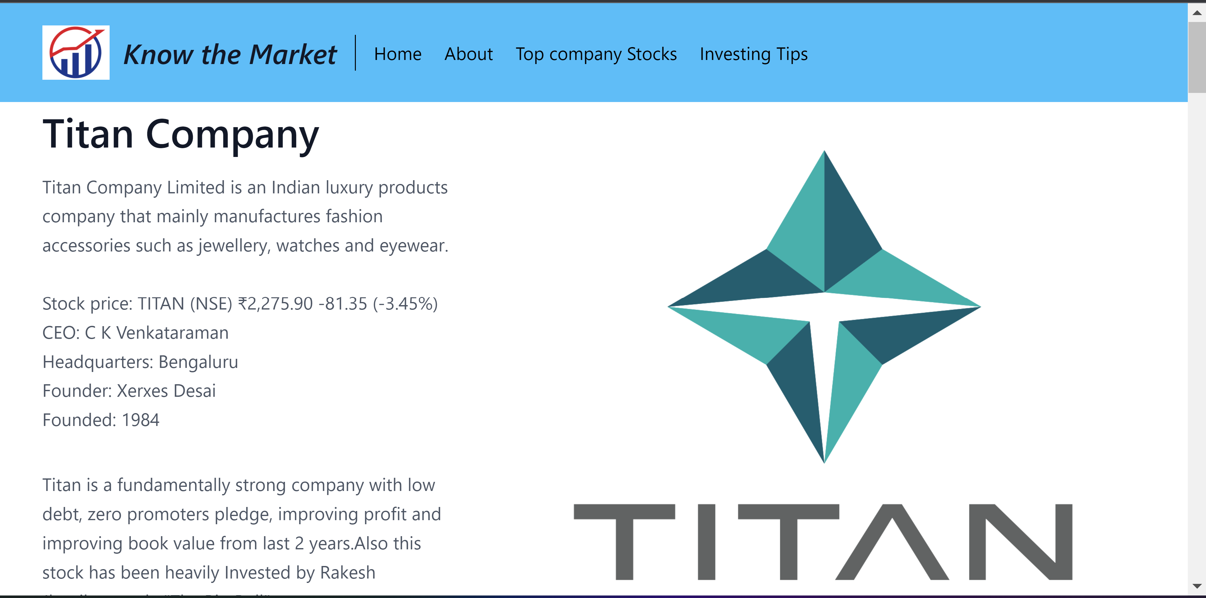
Top Company Stocks Page

Slide 23
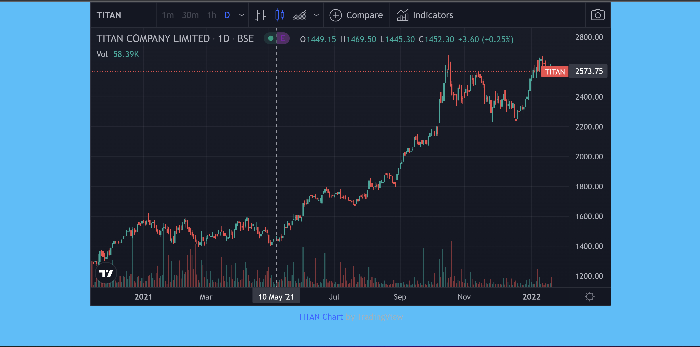
Titan Live graph Widget

Slide 24
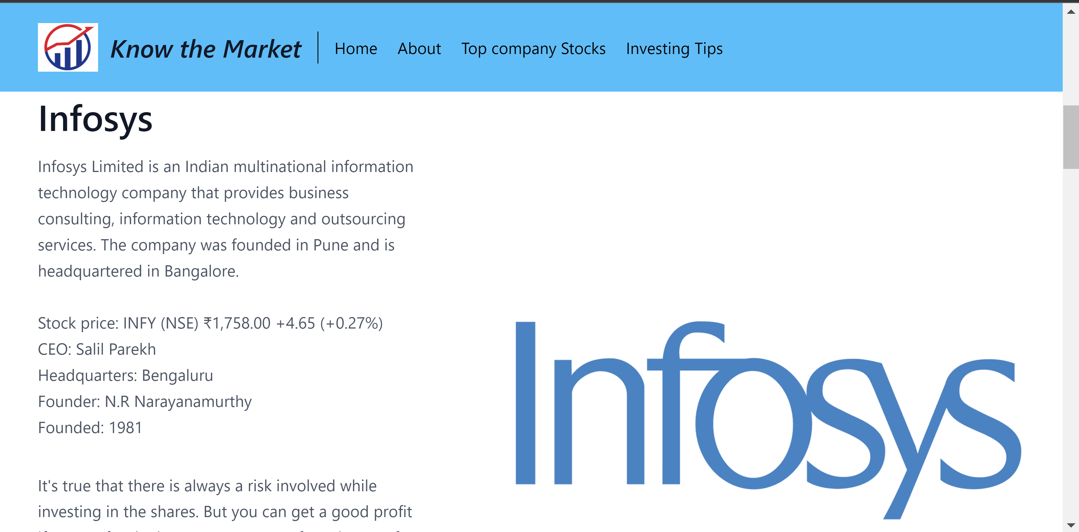

Slide 25
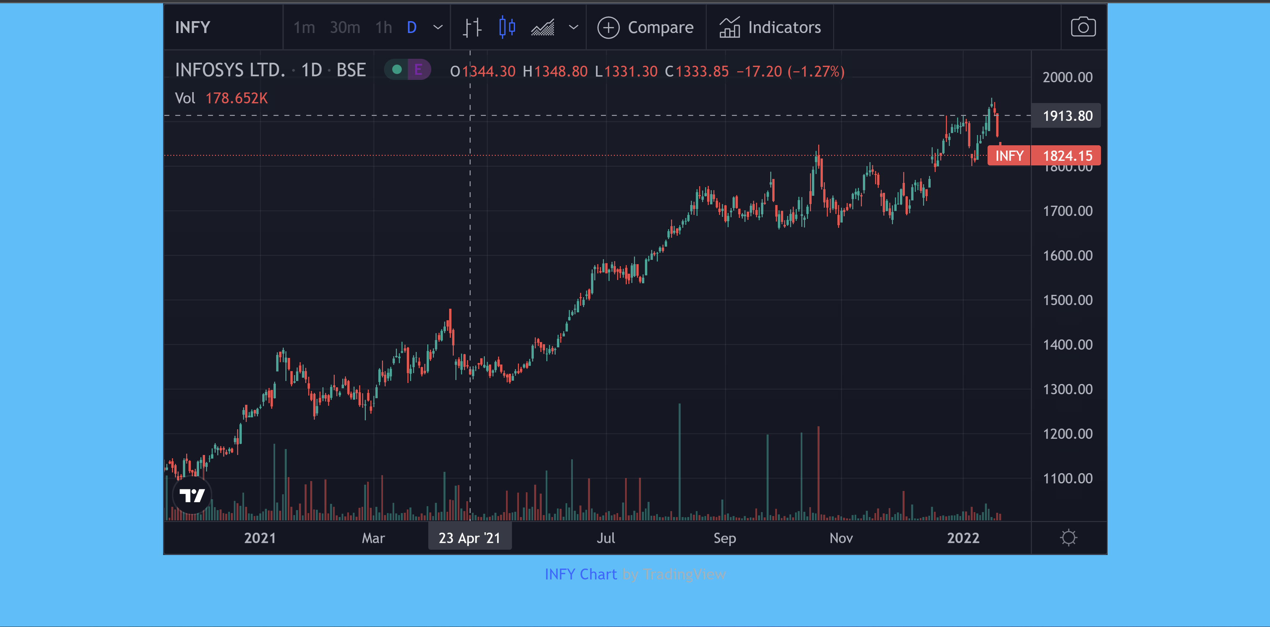
Infosys Live graph Widget

Slide 26
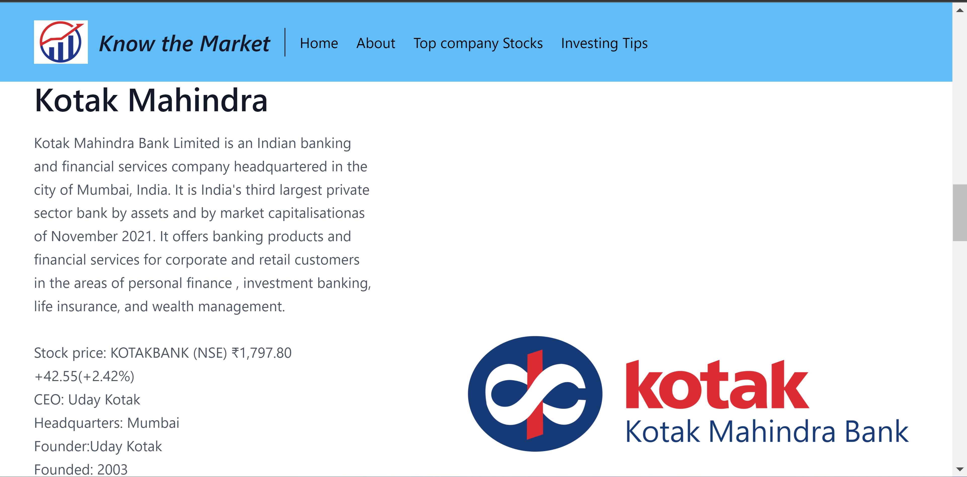

Slide 27
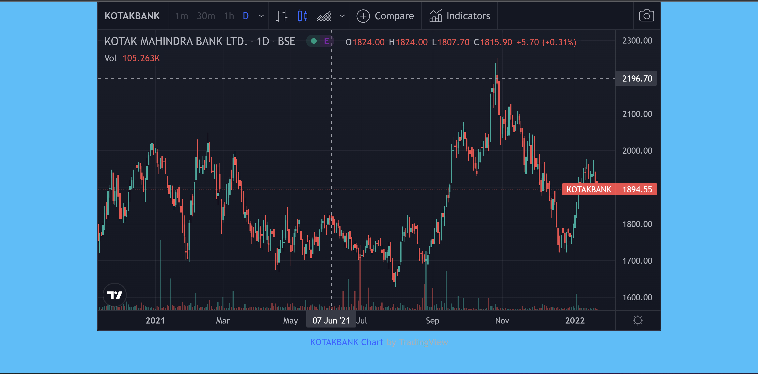
Kotak Mahindra Live graph Widget

Slide 28
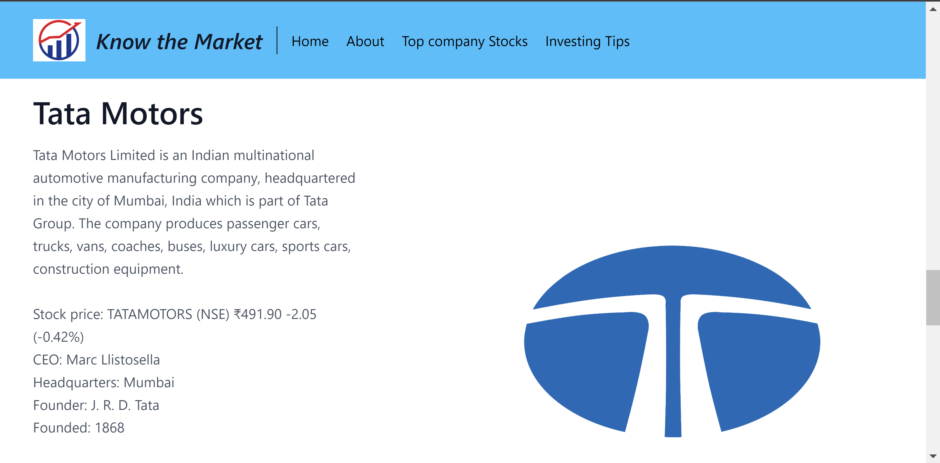

Slide 29
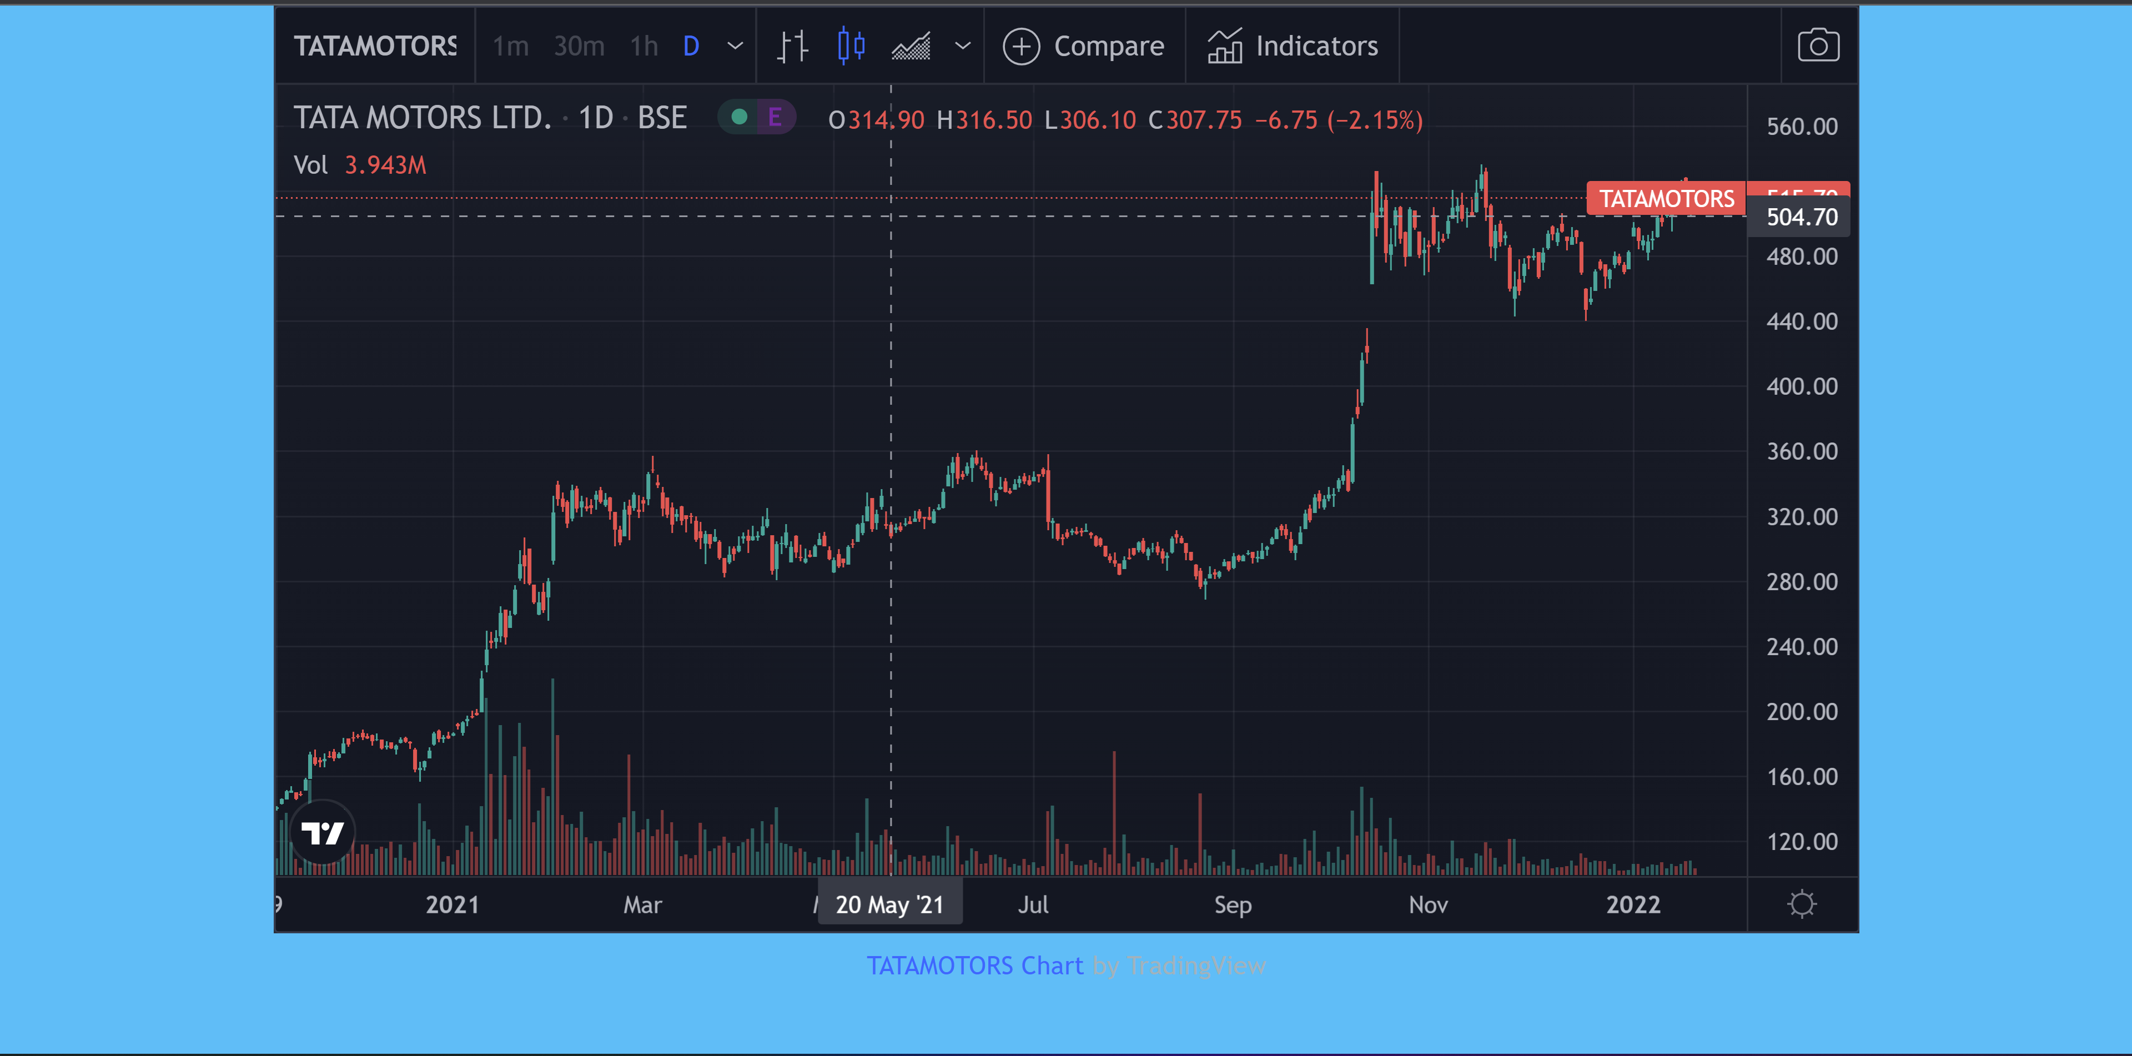
Tata Motors Live graph Widget

Slide 30
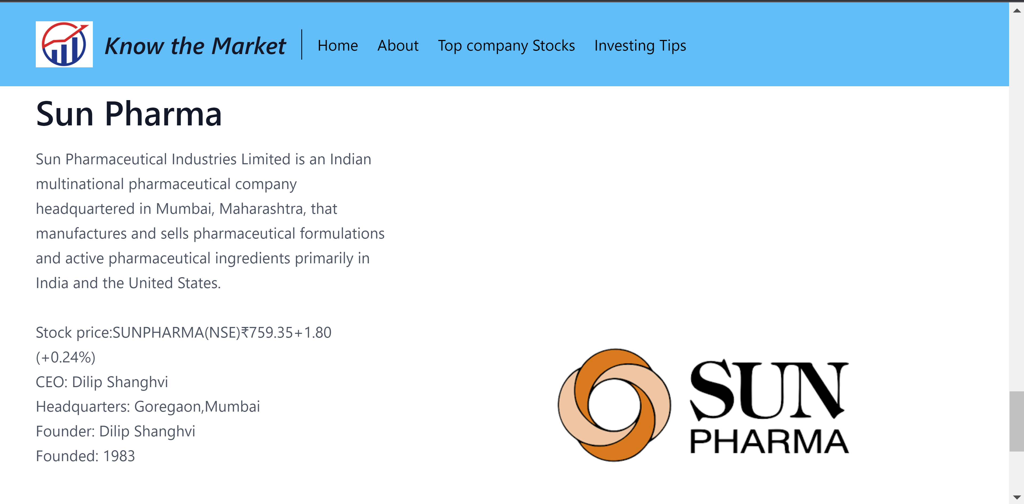

Slide 31
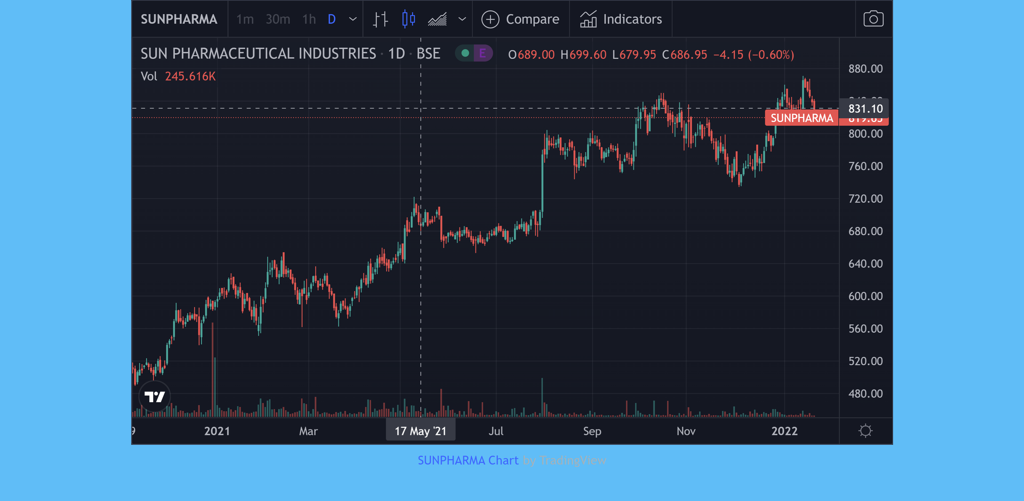
Sunpharma Live graph Widget

Slide 32
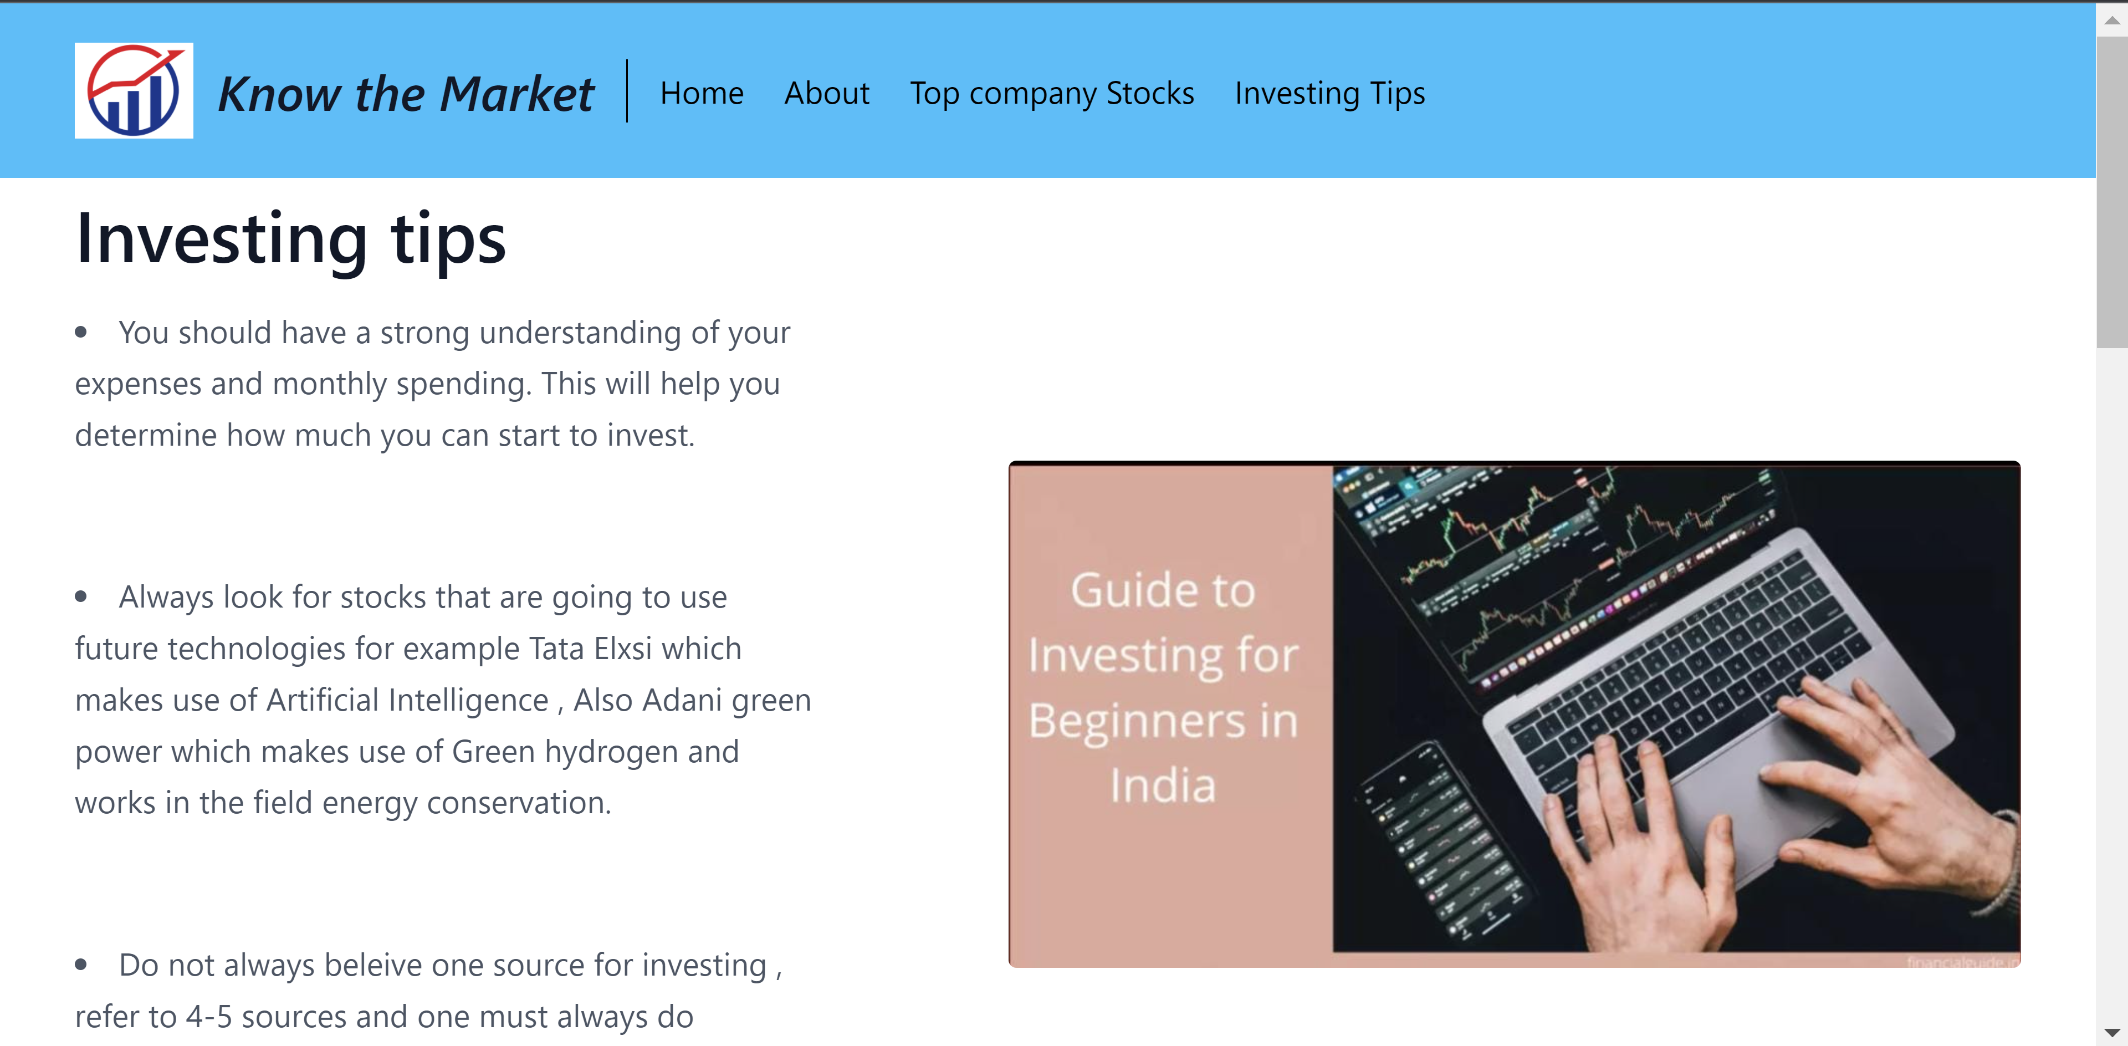
Investing Tips

Slide 33
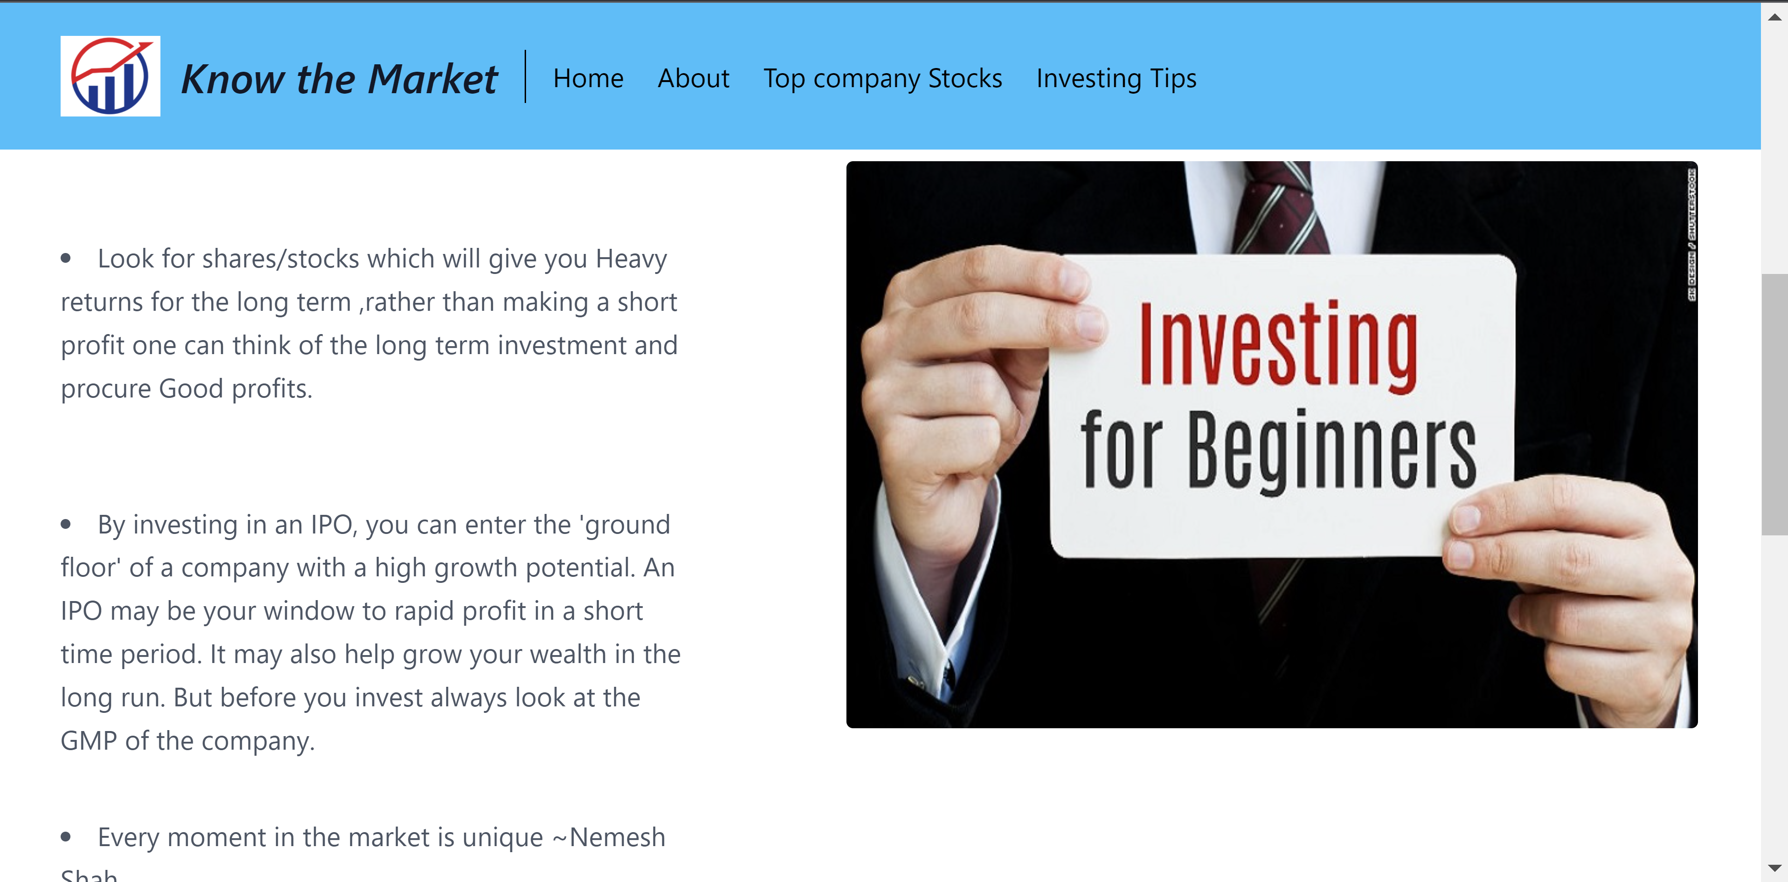

Slide 34
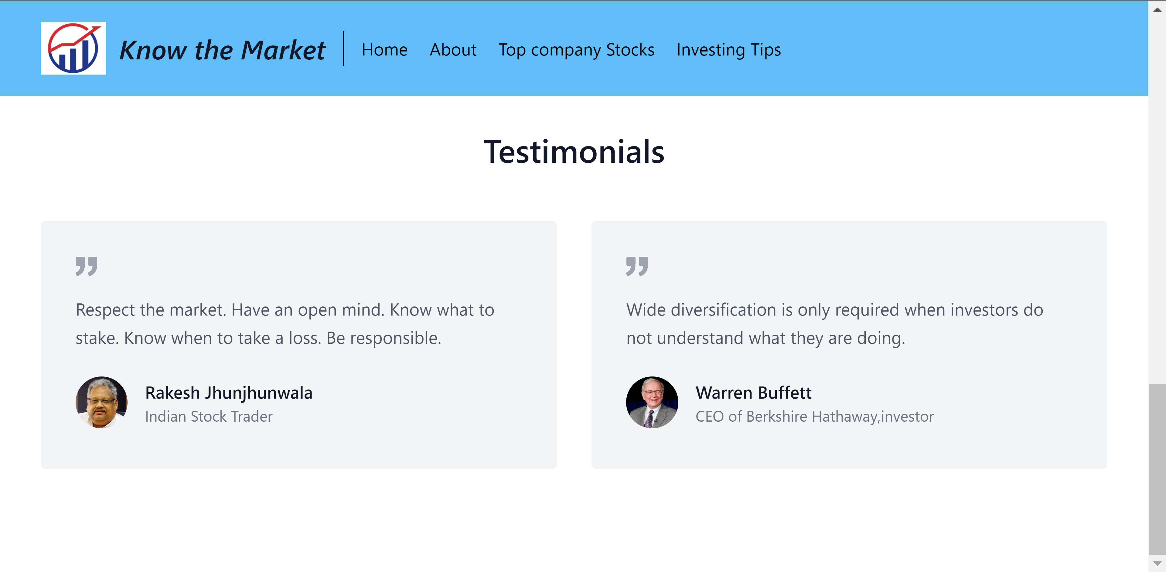

Slide 35
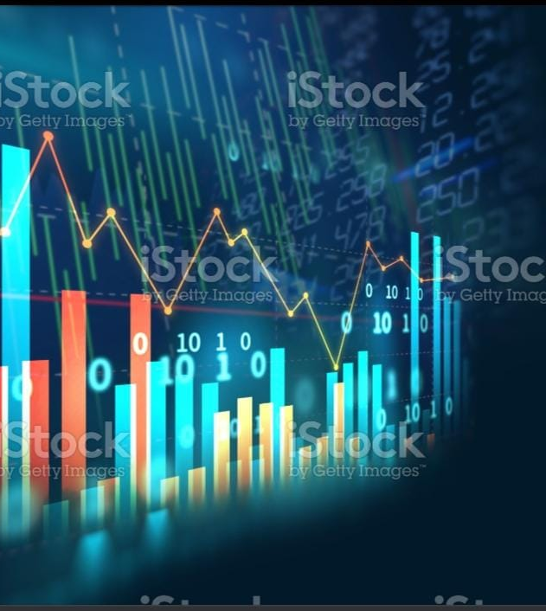
FUTURE SCOPE

Slide 36
Talking about future scope of our project, so far we have Developed basic version of stock market website which aims at providing knowledge. Various other features that can be included in our project are:
Adding complete list of stocks from all sectors
Providing feature to start a portfolio
Trading with live markets
Giving complete financial information about all companies

Slide 37

REFERENCES

Slide 38
https://www.w3schools.com/html/default.asp
https://www.w3schools.com/css/default.asp
https://www.w3schools.com/js/default.asp\
https://www.bseindia.com/
https://www.nseindia.com/
https://www.moneycontrol.com/

Slide 39

THANK YOU

